Slide 1



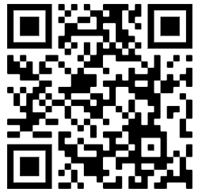
Raspberry Pi Python Workshop
Workshop Material
By
Goh Soon Seng
https://github.com/ssgoh/The-Pi-Club/tree/main/Pi%20Python%20Workshop
PLEASE DO NOT WRITE ANYTHING ON THE PAGES OF THIS BOOKLET. THANK YOU.
Notes:
We do three intro before we begin the workshop – volunteers , objective , training kit

Slide 2
Raspberry Pi Python Workshop
Objectives
Kickstart to learning Python on your own
How to set up a learning environment,
  Installing Python on own PC/Laptop
  Suitable programming platform (IDE)
Tips on how AI tools can be used alongside this environment as a learning coach
Recommend Online Learning Resources
Join our Pi Python Makers Club

Slide 3
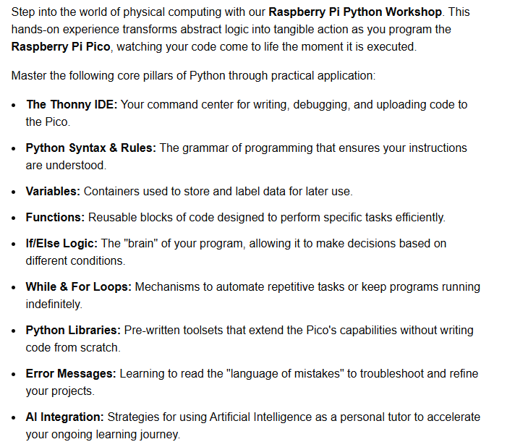
Raspberry Pi Python Workshop

Slide 4
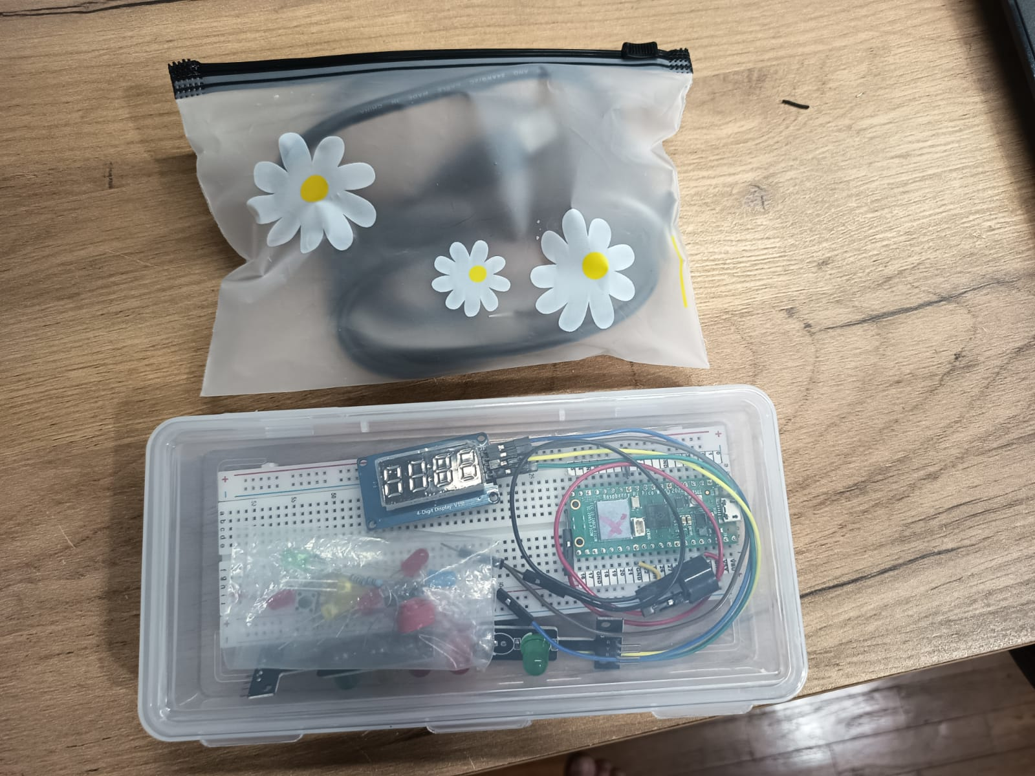
THE RASPBERRY PI PICO TRAINING KIT
Bag of wires
Raspberry Pico
Training kit

Slide 5
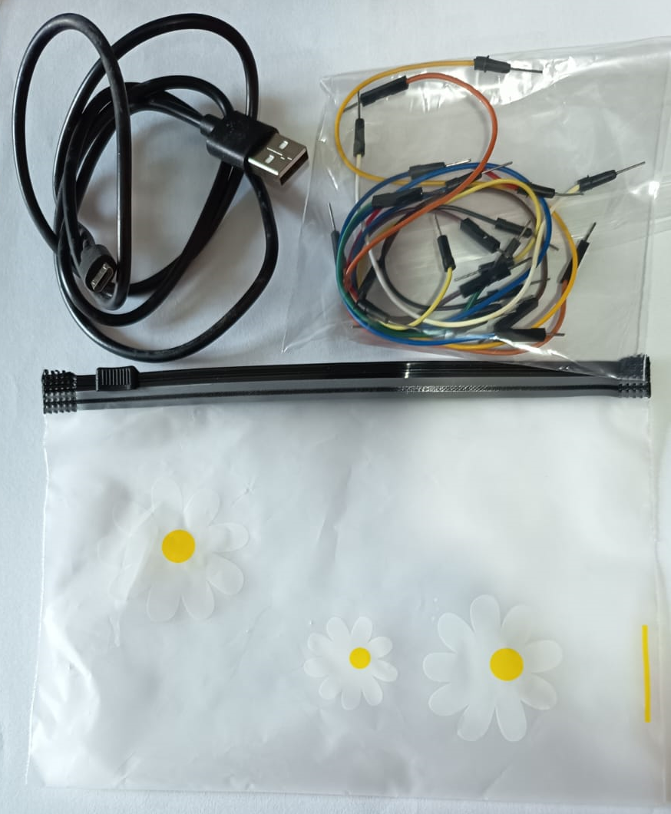
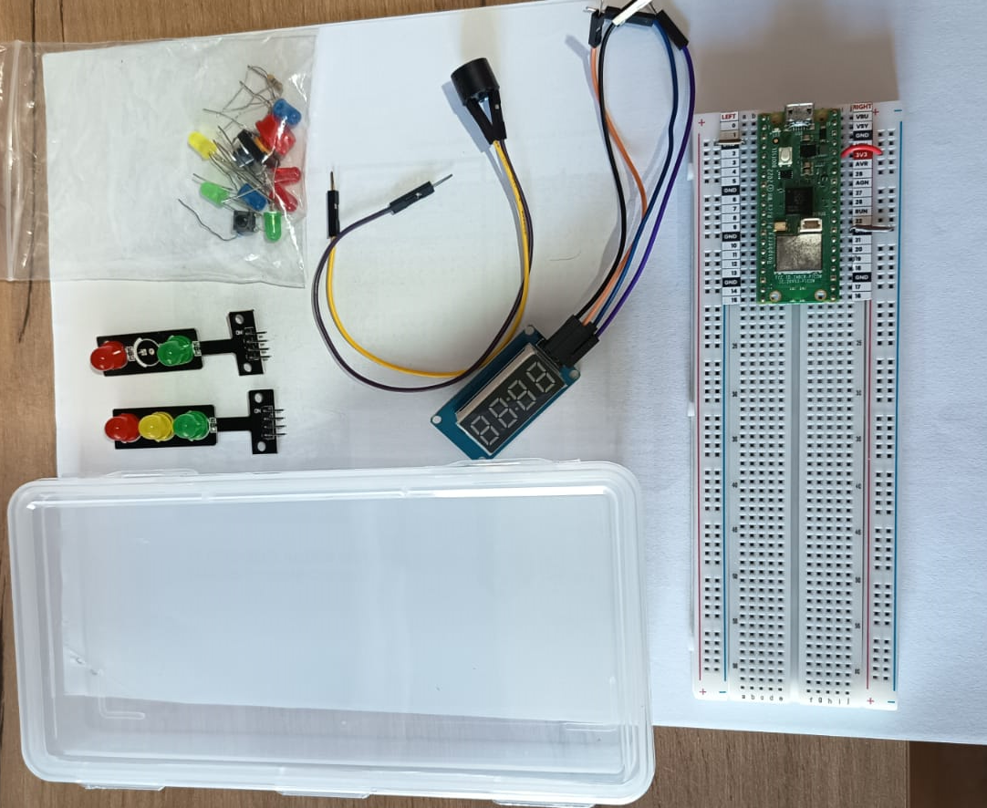
THE RASPBERRY PI PICO TRAINING KIT
JUMPER WIRES
BAG
BOX
USB CABLE
PLEASE PACK THE KIT
INTO IT’S ORIGINAL PACKAGING. THANK YOU

Slide 6
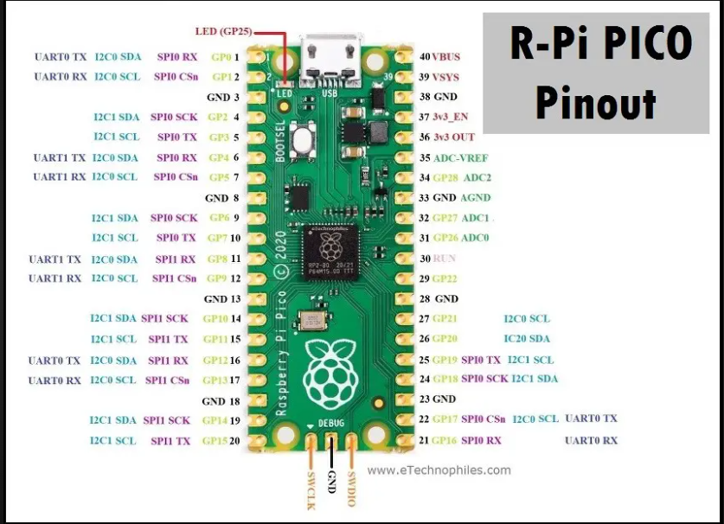
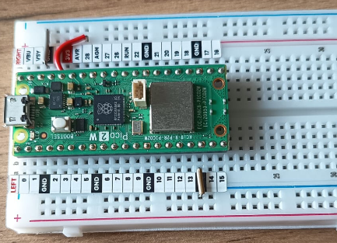

Slide 7
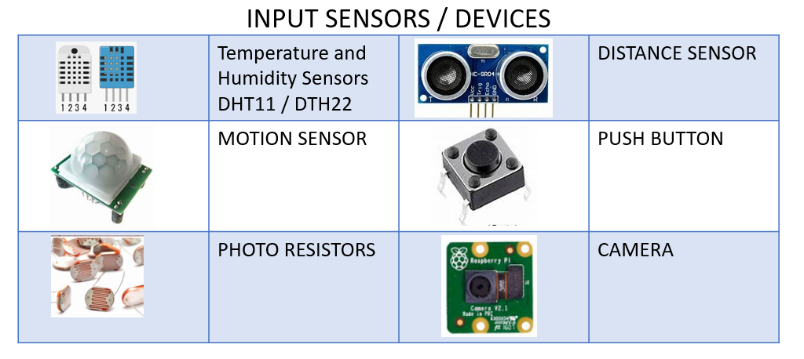
Input devices

Slide 8
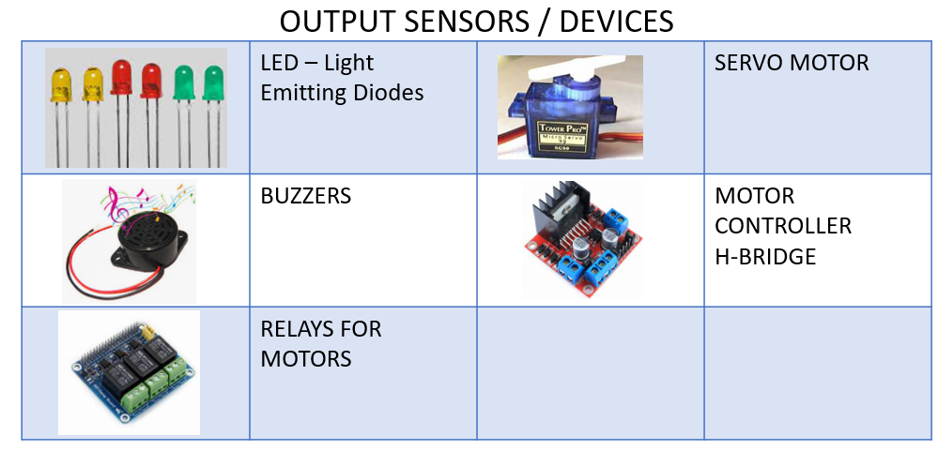
Output devices

Slide 9
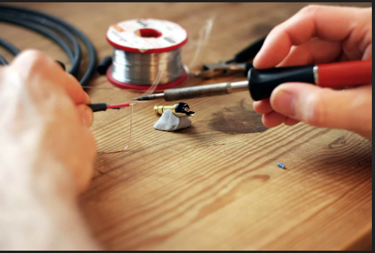
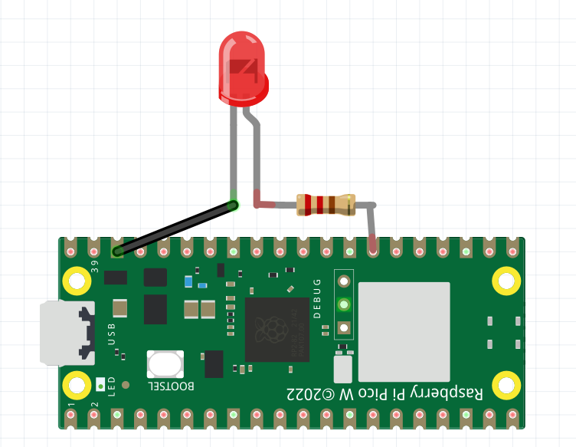
Example of an Electronic Circuit
Solder
Joints

Slide 10
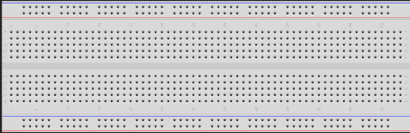
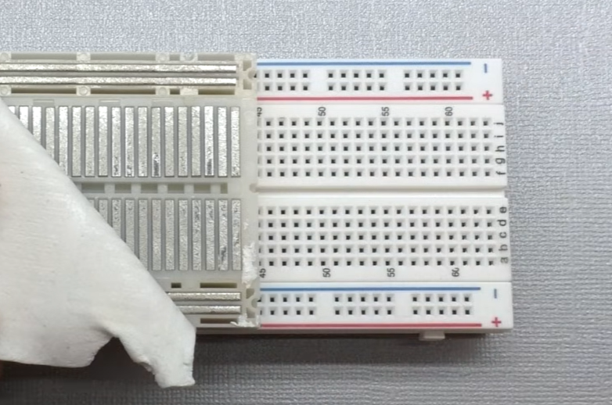
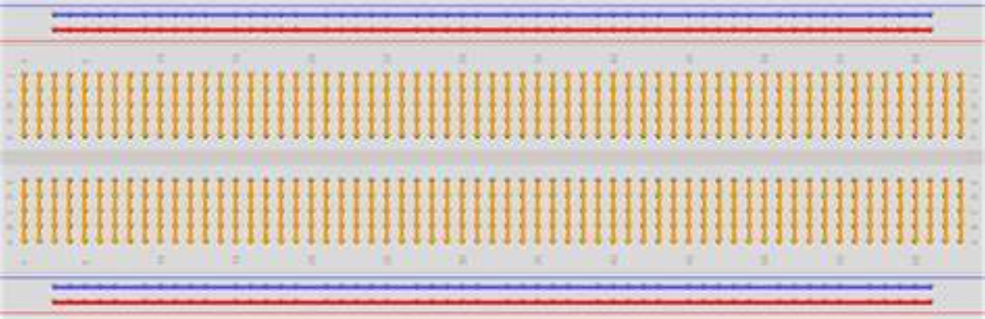
THE BREADBOARD
POWER RAIL
EXTERNAL
GROUND RAIL
INTERNAL
Connections inside the Breadboard

Slide 11
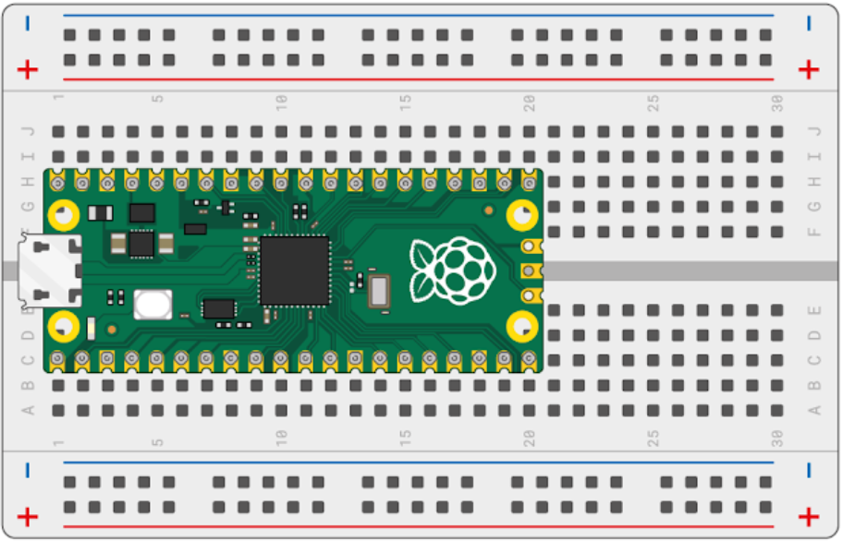
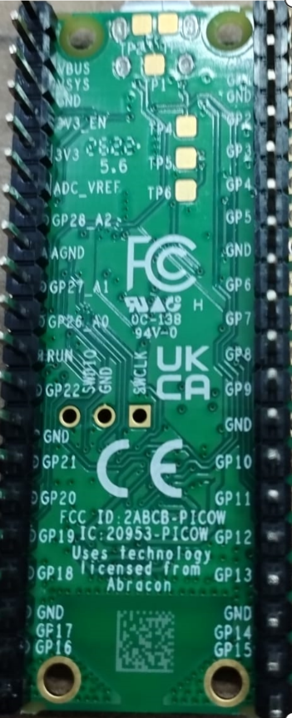
The Pico on a Breadboard

Slide 12
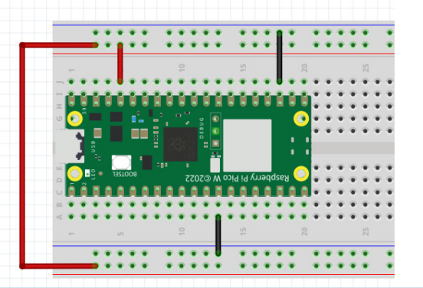
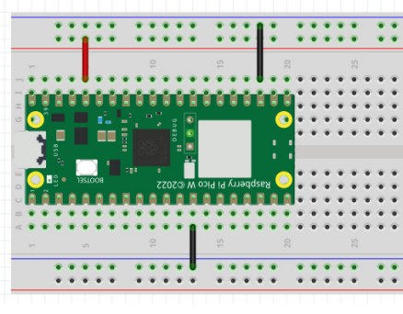
GROUND
GROUND
POWER
POWER
GROUND
GROUND
POWER
WE ARE USING THIS SETUP

Slide 13
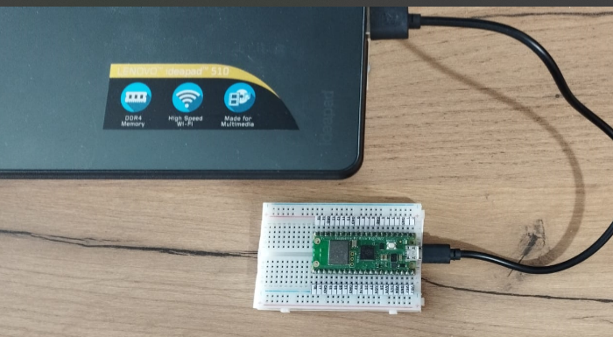

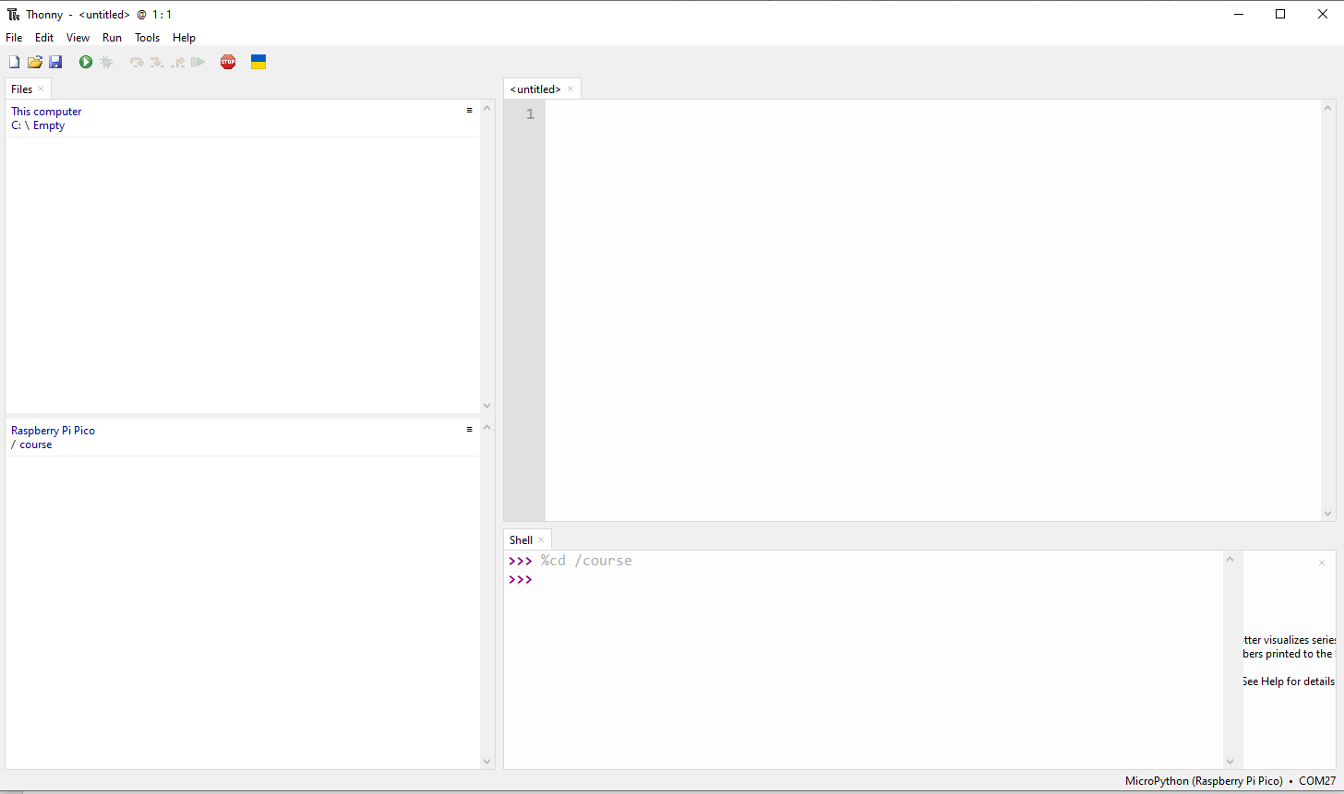
Connecting the Pico to the Laptop
1. Connect the USB Cable to the Pico
2. Connect the other end to the Laptop/PC
Look for this Thonny icon
on the desktop or taskbar
4. Launch Thonny
5. The Pico is now linked to Thonny

Slide 14
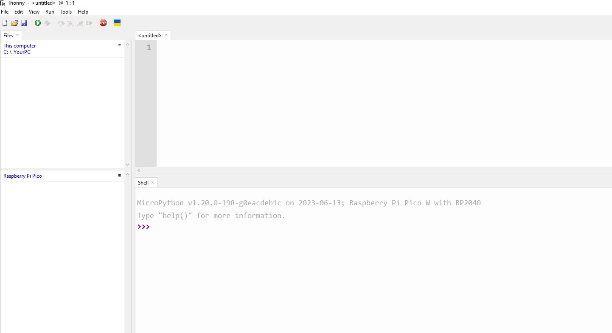
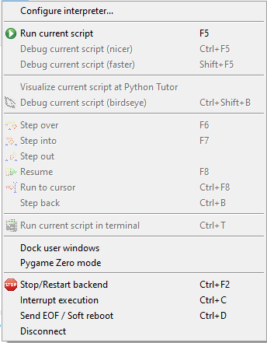
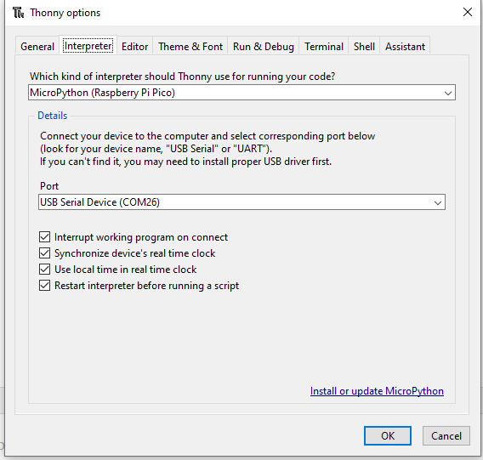
PC’s File Explorer
Program Editor
Pico’s File Explorer
Shell

Slide 15
Python Lesson – Session # 1
LIBRARIES
machine
time
picozero
VARIABLES/NAMES
LOOPS
while True:
PYTHON RULE
Indentation / Code Blocks
Character casing
SAVING YOUR WORK
All Python files has .py extension
ALGORITHM
Formulating what you want the program to do / Recipe

Slide 16
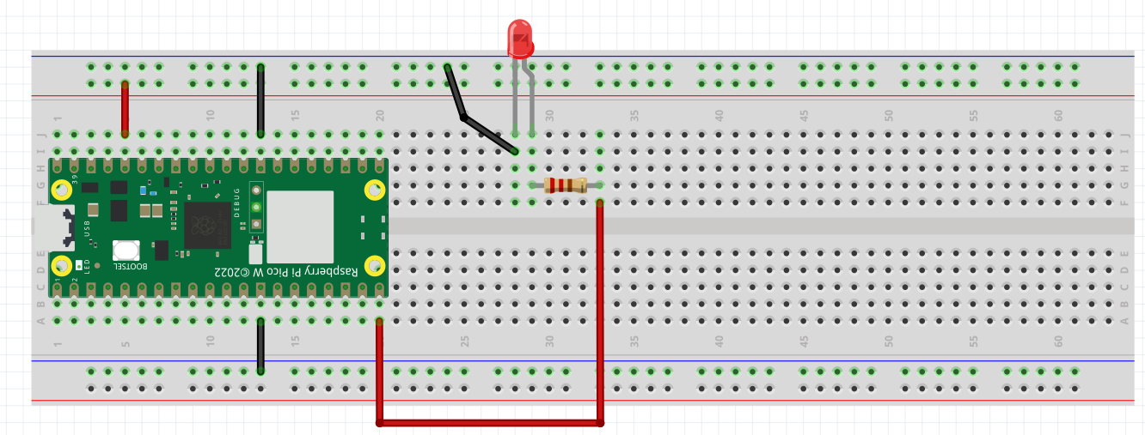
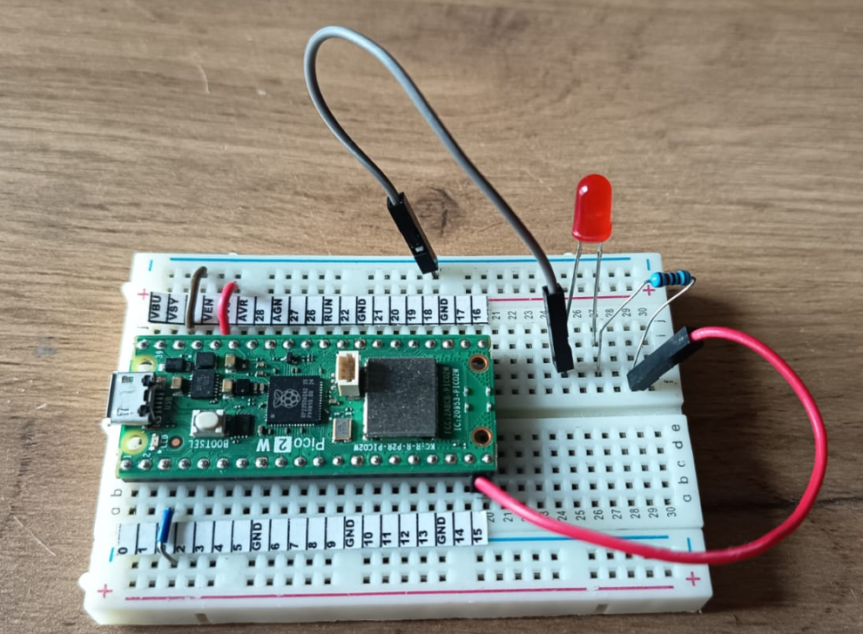
EXERCISE #1
Wiring a Light Emitting Diode (LED)
Please wire up the following circuit
red_led
GROUND
_
3.3V
+
GROUND
200 OHM RESISTOR
GROUND
3.3V
PIN 15

Slide 17
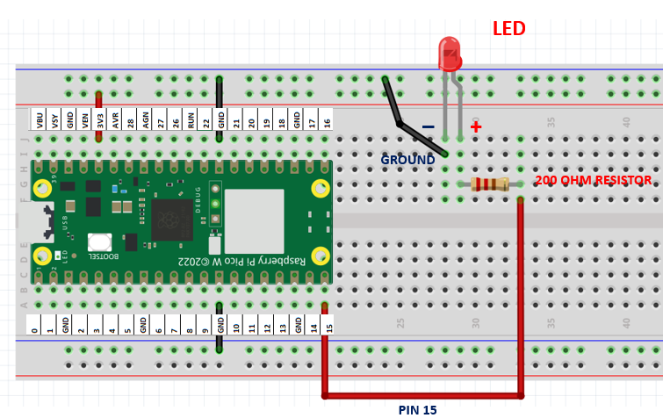

TESTING OUR CIRCUIT USING THONNY SHELL
>>>
Library
red_led
Ex 1a. Turning our Red LED on
>>> from picozero import LED
>>> red_led = LED(15)
Variable
>>> red_led.on()
Ex 1b. Turning it off
>>> red_led.off()
Ex 1c. Blinking the red LED
Can you make it Blink too?
>>> red_led.blink()
The blink interval is 1 second.
What if we have to make the blink faster or slower?
We will need a python program to do that

Slide 18
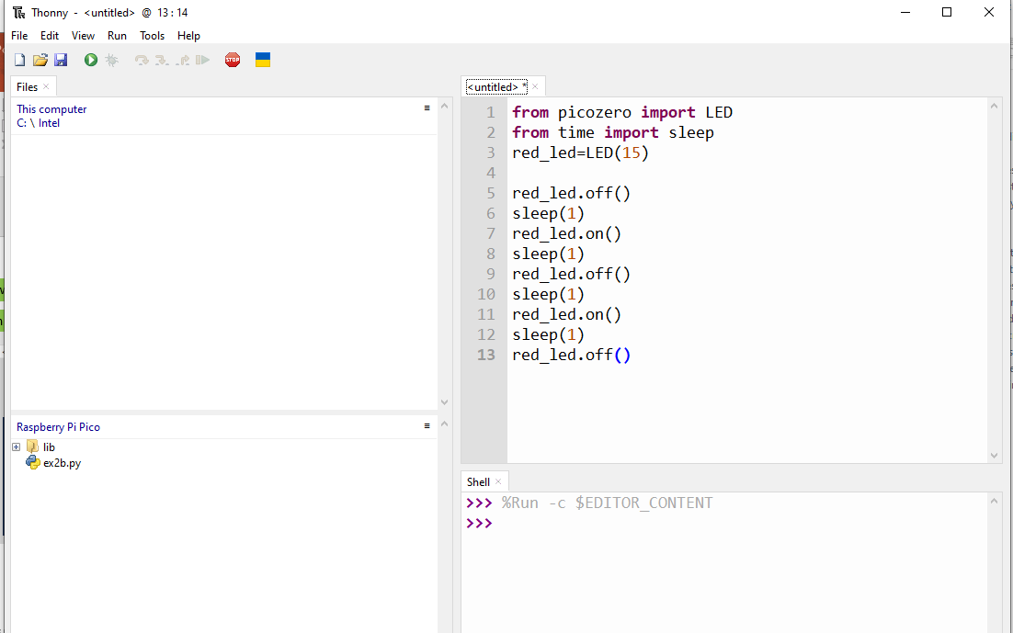
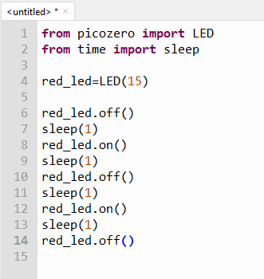
Click here to start a new python program
We start customizing
our blink program with
an ALGORITHM
To run this python program
Editor
Start with red led off
Wait 1 second
Turn red led on
Wait 1 second
Turn red led off
Wait 1 second
Turn red led on
Wait 1 second
Turn red led off
Start with red led off
Wait 1 second
Turn red led on
Wait 1 second
Turn red led off
Wait 1 second
Turn red led on
Wait 1 second
Turn red led off
CODE

Slide 19
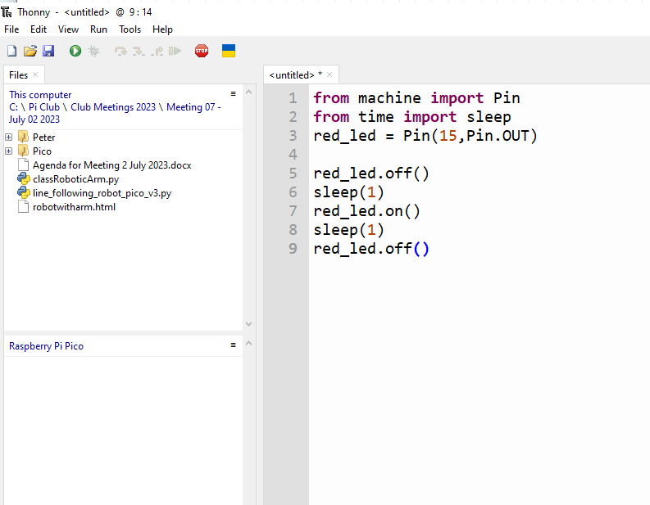
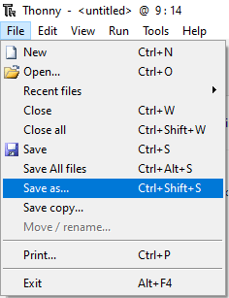
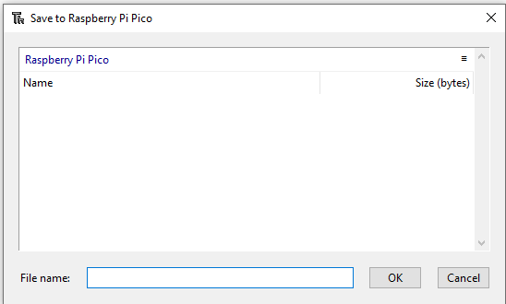
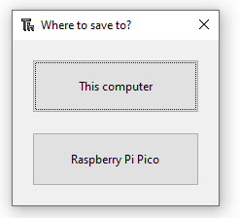
SAVING A PYTHON PROGRAM
ex1c.py
ex1c.py

Slide 20
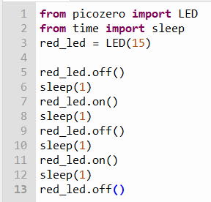
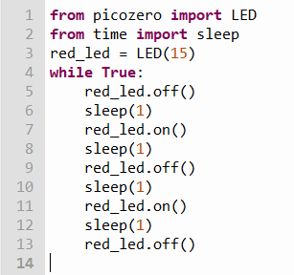
ENDLESS LOOP
Python Syntax Rules
ex1c.py
Convert
indentation
Runs once
Runs forever
Save it as ex1d.py
Run this program

Slide 21
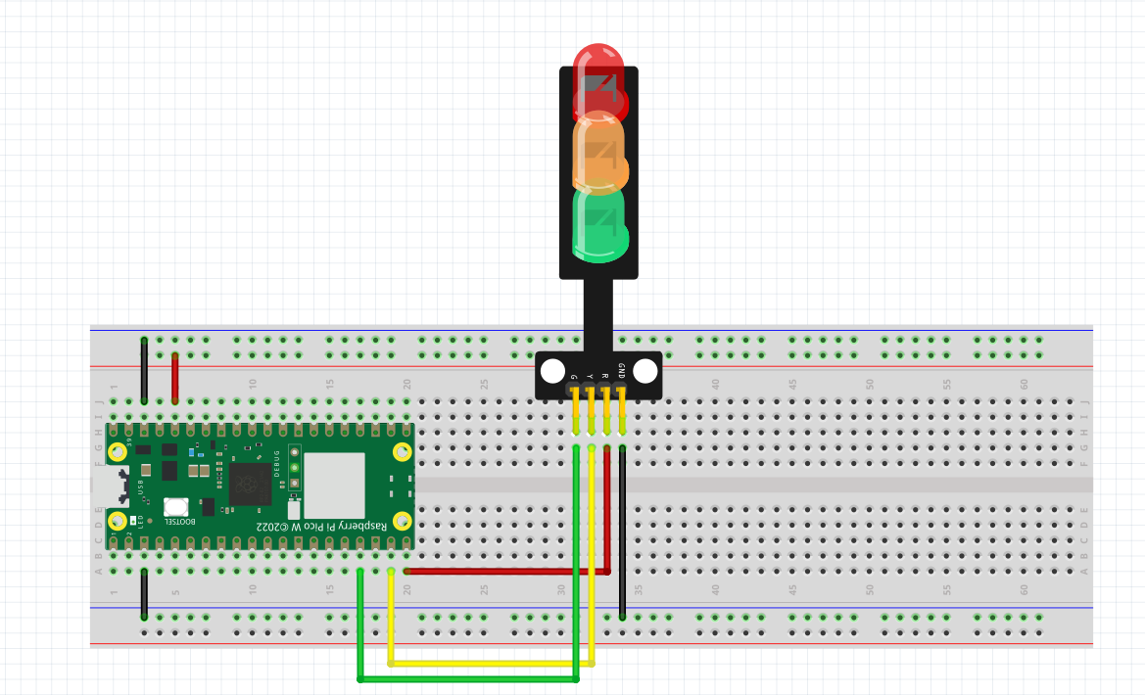
EXERCISE 2 – TRAFFIC LIGHT
Please wire up this new circuit
red_led
yellow_led
green_led
GROUND
3.3V
PIN 15
GROUND
PIN 14
PIN 13

Slide 22
EXERCISE 2 – CONTROLLING MULTIPLE LEDs
Ex 2a. Test the Circuit. Turn each of the LEDs ON and OFF
>>> from picozero import LED
>>> red_led= LED(15)
>>> yellow_led = LED(14)
>>> green_led=LED(13)
hint
Ex 2b. Turning the circuit into a Traffic Light System
Algorithm
Code
How does a traffic light work?
Green Light On
Give cars 10 seconds to cross
Green Light Off
Yellow Light On
Give 5 seconds warning
Yellow Light Off
Red Light On
Wait 10 seconds
Red Light Off
green_led.on()
sleep(10)
green_led.off()
yellow_led.on()
sleep(5)
yellow_led.off()
red_led.on()
sleep(10)
red_led.off()
How?
Code this in the editor
Run and save it as ex2b.py

Slide 23
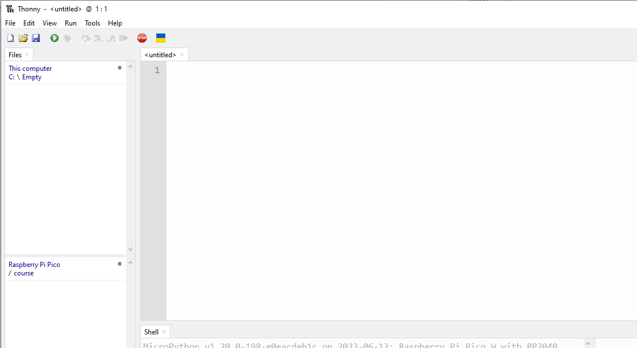
Lets create this program together
from picozero import LED
from time import sleep
red_led = LED(15)
yellow_led=LED( 14 )
green_led=LED( 13 )
green_led.on()
Run this program
Green Light On
Give cars 10 seconds to cross
Green Light Off
Yellow Light On
Give 5 seconds warning
Yellow Light Off
Red Light On
Wait 10 seconds
Red Light Off
sleep(10)
Save program as ex2c.py
green_led.off()
yellow_led.on()
sleep(5)
yellow_led.off()
red_led.on()
sleep(10)
red_led.off()

Slide 24
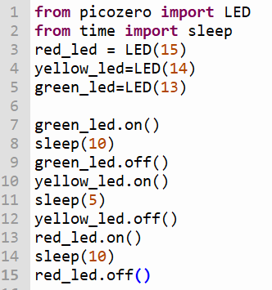
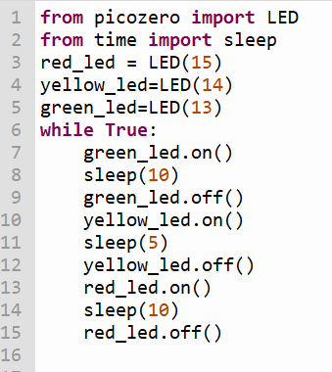
ex2c.py
convert
Runs forever
Runs once
Run the Program
Save it as ex2d.py

Slide 25
Python Lesson – Session # 2
FUNCTIONS
LOOPS
for loop
MESSAGING
how humans and machine communicate with each other

Slide 26
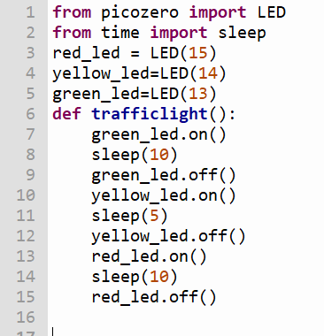

FUNCTION – A SET OF CODES WITH A NAME
ex2d.py
Run the Program
Save it as ex2e.py

Slide 27
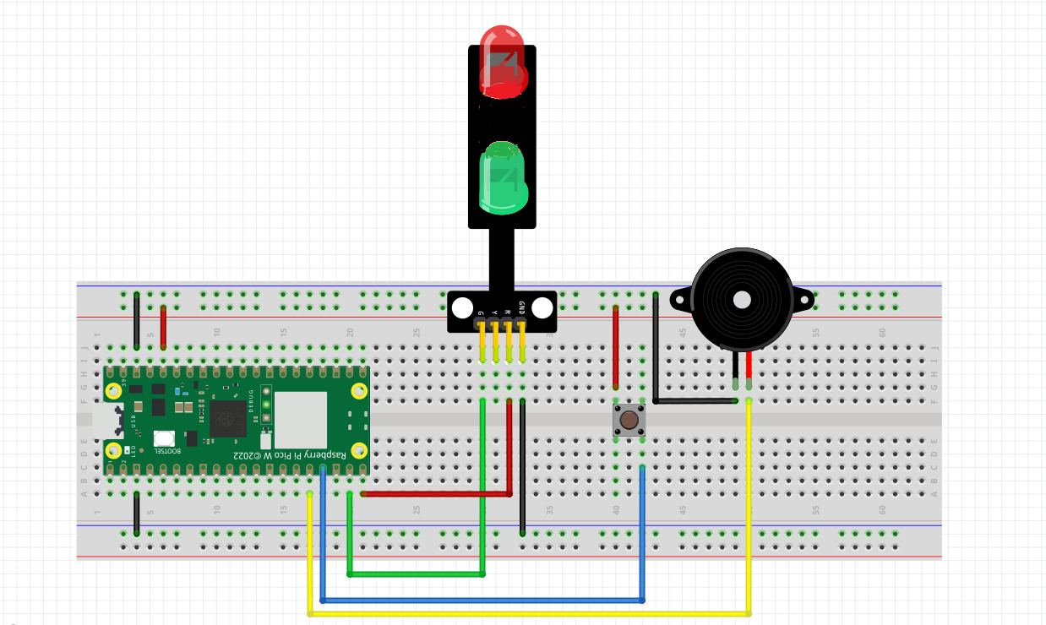
Exercise 3 – Wiring a Pedestrian Crossing
Look for + sign on the Buzzer
BUZZER
+
+
PIN 15
PIN 14
PIN 13
PIN 12
PIN 12

Slide 28
TESTING OUR CIRCUIT USING THONNY SHELL
Ex 3a. Turning our Buzzer on
>>> from picozero import Buzzer
>>> buzzer= Buzzer(12)
>>> buzzer.on()
Ex 3b. Turning it off
>>> buzzer.off()
Ex 3b. Setting up multiple sensors : our circuit has Buzzer, Button, LED
>>> from picozero import Buzzer, Button, LED
>>> buzzer= Buzzer(12)
>>> button=Button(13)
>>> red_led=LED(15)
Let’s say we want the LED
To light up when we press the button
And off when we release the button
>>> button.when_pressed = red_led.on
>>> button.when_released = red_led.off
Let’s say we want the BUZZER
To buzz when we press the button
And off when we release the button
>>> button.when_pressed = buzzer.on
>>> button.when_released = buzzer.off

Slide 29
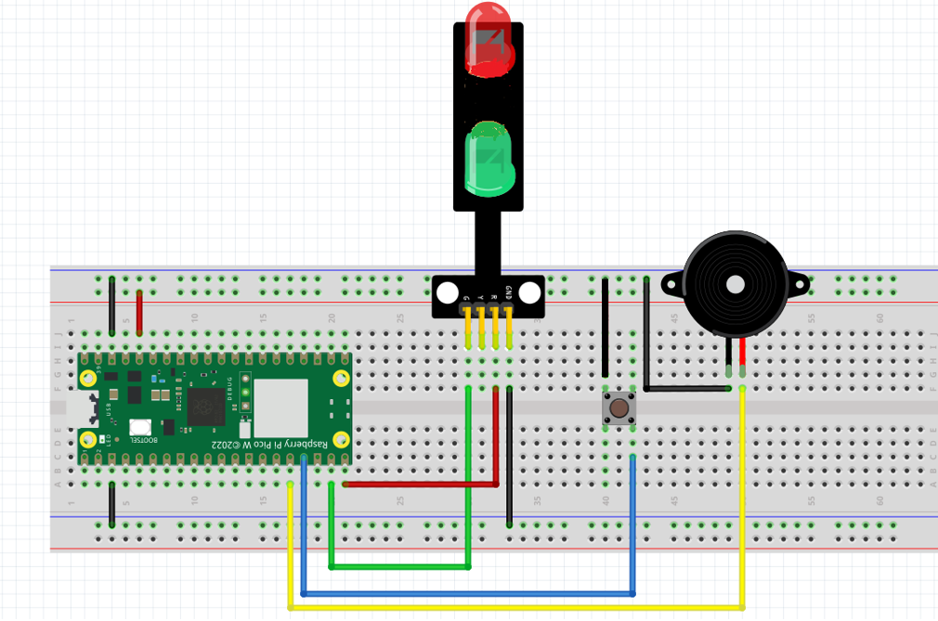
Exercise 3 – Pedestrian crossing : Algorithm to code
from picozero import LED, Buzzer, Button
from time import sleep
red_led = LED(15)
green_led=LED(14)
buzzer=Buzzer(12)
button=Button(13)
red_led.on()
green_led.off()
HOW DOES A PEDESTRAIN CROSSING WORK?
sleep(10)
red_led.off()
RED LED IS ON / GREEN LED IS OFF
WAIT FOR 10 SECONDS
RED LED GOES OFF
GREEN LED GOES ON
GIVE 10 SECONDS FOR PEOPLE TO CROSS
GREEN LED GOES OFF
RED LED TURNS ON
green_led.on()
convert
sleep(10)
green_led.off()
TO CODE
red_led.on()
RUN and
Save this program as ex3c.py

Slide 30
Exercise 3 – Turning the circuit into a pedestrian crossing with code
from picozero import LED, Buzzer, Button
from time import sleep
red_led = LED(15)
green_led=LED(14)
buzzer=Buzzer(12)
button=Button(13)
while True:
red_led.on()
green_led.off()
sleep(10)
red_led.off()
green_led.on()
sleep(10)
green_led.off()
red_led.on()
red_led.on()
green_led.off()
sleep(10)
red_led.off()
green_led.on()
sleep(10)
green_led.off()
red_led.on()
RUN AND SAVE
PROGRAM AS
ex3d.py
RUN ONCE
convert
RUN FOREVER

Slide 31
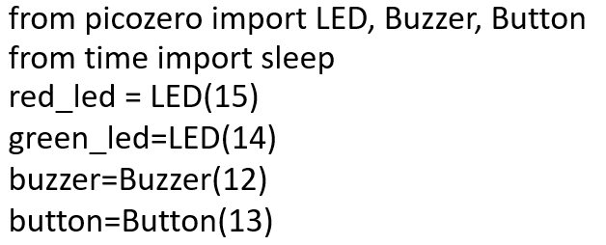

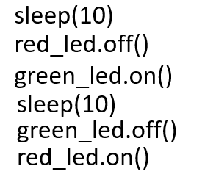
ex3d.py
from picozero import LED, Buzzer, Button
from time import sleep
red_led = LED(15)
green_led=LED(14)
buzzer=Buzzer(12)
button=Button(13)
red_led.on()
green_led.off()
How to convert this into a functon
def greenman():
Run program
Save it as ex3e.py
while True:
sleep(10)
red_led.off()
Give a name for your function. Let’s call it
greenman()
green_led.on()
sleep(10)
green_led.off()
red_led.on()
while True:
greenman()

Slide 32

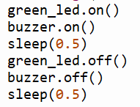
ex3e.py
BEFORE THE GREEN LIGHT GOES OFF, WE WANT TO
ALERT THE PEDESTRIAN BY FLASHING THE GREEN LED AND BUZZER
How?
WHERE in the
program
to add this function?
def greenman():
10 X
while True:
greenman()

Slide 33
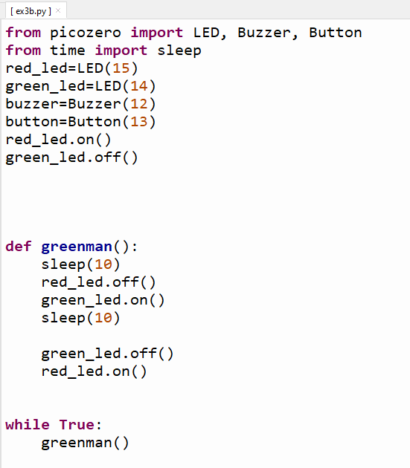
ex3e.py
Run program
Save it as ex3f.py

Slide 34
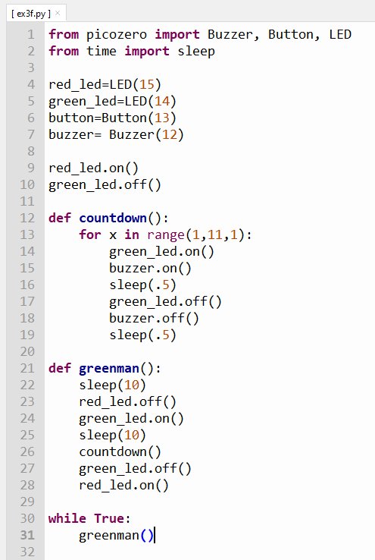


ex3f.py
This program works fine.
But in the real world, it’s not practical.
Why?
If no one wants to cross, the program will still continue to work
We want this program to run only
when someone presses the button. How can we make use of the button
Make this change
Run program
Save it as ex3g.py

Slide 35
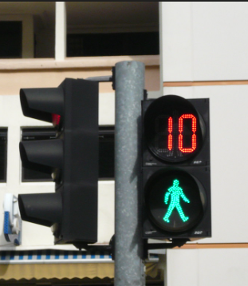
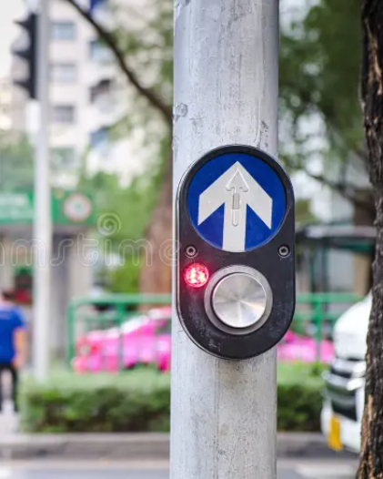
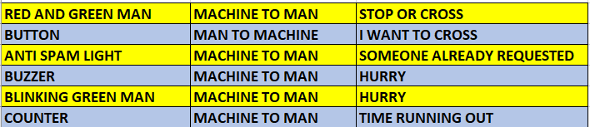
HOW DO HUMANS AND MACHINES
COMMUNICATE IN THE REAL WORLD?
WHAT DO YOU SEE AT A PEDESTRIAN CROSSING?
RED AND GREEN MAN
BUTTON
ANTI SPAM LIGHT
BUZZER
BLINKING GREEN MAN
COUNTER

Slide 36


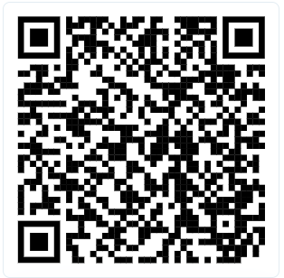
HOME WORK (OPTIONAL)
Install ChatGPT app on your phone
Bring a thumb drive if you want to save your work
Install Thonny on own laptop/computer:
Search for Thonny in browser
Follow the lesson on this video
https://youtu.be/A2NnIWCYnMQ?si=gOc3Jojl_TgXHxmE
Run the installation. Thonny will be installed together with Python

Slide 37
Python Lesson – Session # 3
LIBRARY
tm1637
FUNCTIONS
CONDITIONAL STATEMENTS
if else
LOOPS
for loop

Slide 38


Exercise 4 – Full Fledge Pedestrian Crossing
CLK – Pin 19
DIO – Pin 18
Markings on reverse side
+
PIN 15
PIN 14
PIN 13
PIN 12
PIN 11
We need another Library
to work with this device,
called a 7 Segment Display
Library: tm1637.py

Slide 39


EXERCISE 4a – THE 7 SEGMENT DISPLAY
>>> from machine import Pin
>>> import tm1637
>>> tm = tm1637.TM1637(clk=Pin(19), dio=Pin(18))
>>> tm.show(“help”)
In python " " * 4 means 4 SPACES
This will clear the display.
Make sure there is a SPACE in between the quotation marks
>>> tm.number(1234)
>>> tm.temperature(24)
>>> tm.show(" " * 4)
Exercise 4a. Display the following
PICO
95
70 Degrees Celcius
Clear the display

Slide 40
COUNT DOWN DISPLAY
from machine import Pin
from time import sleep
import tm1637
tm = tm1637.TM1637(clk=Pin(19), dio=Pin(18))
for x in range(10,-1,-1):
tm.number(x)
sleep(1)
Run program
Save as ex4b.py
Try Counting from 0 to 10.
Refer to ex3f.py if you are not sure how to count upwards

Slide 41

Modify ex3g.py to add
Count down to
countdown()
Besides the green man
flashing and the buzzer
beeping
the counter will show
how much time left
for crossing
countdown()
tm.show(“ “ * 4)
Run this amended program
Save as ex4c.py

Slide 42
Anti Spamming – Logical Diagram
PEDESTRAIN CROSSING BUTTON PRESSED
ANTI SPAM ON?
YES
PASS
NO
TURN ANTI SPAM LED ON
RUN greenman()

Slide 43




MODIFY ex4c.py to add antispam control
4)
PEDESTRAIN CROSSING BUTTON PRESSED
ANTI SPAM ON?
YES
PASS
NO
TURN ANTI SPAM LED ON
RUN greenman()
Run Program
Save as ex4d.py

Slide 44
def greenman():
sleep(10)
red_led.off()
green_led.on()
sleep(10)
countdown()
green_led.off()
red_led.on()
antispam_led.off()
tm.show(" " * 4)
button.when_pressed= check
from picozero import LED, Buzzer, Button
from machine import Pin
import tm1637
from time import sleep
red_led=LED(15)
green_led=LED(14)
buzzer=Buzzer(12)
button=Button(13)
tm=tm1637.TM1637(clk=Pin(19),dio=Pin(18))
antispam_led=LED(11)
antispam_led.off()
red_led.on()
green_led.off()
tm.show(" " * 4)
def countdown():
for x in range(10,-1,-1):
tm.number(x)
green_led.on()
buzzer.on()
sleep(0.5)
green_led.off()
buzzer.off()
sleep(0.5)
def check():
if antispam_led.value == 1:
pass
else:
antispam_led.on()
greenman()

Slide 45
END

Slide 46


Patrol Car Ex – Putting knowledge gained to use
Use your blue , red LED and a Buzzer to make a noisy flashing lights on a patrol car
Choose any pin you wish
Wire up the circuit and write the python code to make it work
Use this example
HINT
Material
1 x Red LED
1 x Blue LED
1 x Buzzer
Python Code
picozero and time library
while True:
Red LED on and off
Blue LED on and off
Sleep in between on and off
Save your program
As patrolcar.py
And RUN

Slide 47

Solution

Slide 48
Python Lesson – Session # 4
INTRODUCTION TO CHATGPT
GENERATING A PYTHON PROGRAM USING CHATGPT
  Using Prompts
  Using a sketch

Slide 49



Python Lesson – Session # 4
INTRODUCTION TO CHATGPT
GENERATING A PYTHON PROGRAM USING CHATGPT
          Using Prompts
  Using a sketch

Slide 50




Python and AI

Slide 51

Python Lesson – Session # 4
CONTINUING LEARNING PYTHON ON YOUR OWN
Video Resources
https://github.com/ssgoh/The-Pi-Club/blob/main/Pi%20Python%20Workshop/Recommended%20Video%20Resources.txt

Slide 52
Python Lesson – Session # 4
Sample Training Videos / AI as a Tutor
  https://www.youtube.com/watch?v=Ro_MScTDfU4
  Learn Python Programming in Only 30 Minutes
  https://www.youtube.com/watch?v=ix9cRaBkVe0
  Full python course for free
  https://www.youtube.com/watch?v=sFLRrsIln4k
  How to Learn Python With AI
  https://www.youtube.com/watch?v=nMCOB8KElwo
User input in Python is easy + exercises
https://github.com/ssgoh/The-Pi-Club/blob/main/Pi%20Python%20Workshop/Recommended%20Video%20Resources.txt

Slide 53

https://sg.cytron.io/search?search=NLB
NLBKITSPECIAL826

Slide 54
PI PYTHON MAKERS CLUB
TAMPINES REGIONAL LIBRARY
MAKEIT SPACE
Email me : iamssgoh@gmail.com
Pi Python Makers Club

Slide 55
END OF WORKSHOP

Slide 56
EXERCISE 5 – USING CHATGPT
TO GENERATE A PYTHON PROGRAM
red_led
Create a micropython program for pico w
Using the picozero library.
A traffic light system with
Red LED on Pin 15, Yellow LED on Pin 14,
Green LED on Pin 13. Use conventional
Traffic light system
yellow_led
green_led
GROUND
3.3V
PIN 15
GROUND
PIN 14
PIN 13

Slide 57
EXERCISE 5A – USING CHATGPT
TO GENERATE A PYTHON PROGRAM
red_led
Make a screen shot of this image
Open it Paint
Crop out the Traffic Diagram
Save the cropped-out image as
TrafficLight.png
yellow_led
green_led
Go to ChatGPT
Upload TrafficLight.png
Then request it to generate the python code
GROUND
Suggested Prompt:
Using the attached image
Generate a micropython program
For Pico W. Use picozero library
3.3V
PIN 15
GROUND
PIN 14
PIN 13

Slide 58
Exercise 5B – DO THIS ON YOUR OWN
Look for + sign on the Buzzer
BUZZER
+
+
PIN 15
PIN 14
PIN 13
PIN 12
PIN 12

Slide 59



CIRCUIT DIAGRAM

Slide 60
Example of an electronic circuit
Solder
joints

Slide 61


THE UBIQUITOUS BUTTON
THEY MOVE THE WORLD AROUND US
THEY WORK ROUND THE CLOCK
NOTHING GETS DONE WITHOUT THEM
THEY ARE OUR INTERMEDIARIES
WE PRESS THEM ALL THE TIME, YET THEY ARE PATIENT

Slide 62



BUTTONS ARE EVERYWHERE IN THE REAL WORLD
HUMANS CANNOT DIRECTLY INTERACT WITH ELEVATOR SYSTEM
INTERACTION BETWEEN HUMANS AND THE REAL WORLD VIA A COMPUTER SYSTEM
ELEVATOR CONTROL SYSTEM
US HUMANS

Slide 63
Python Lesson – Session # 1
LIBRARIES
machine
time
picozero
VARIABLES/NAMES
LOOPS
while True:
PYTHON RULE
Indentation / Code Blocks
Character casing
SAVING YOUR WORK
All Python files has .py extension
ALGORITHM
Formulating what you want the program to do / Recipe

Slide 64
Python Lesson – Session # 2
FUNCTIONS
LOOPS
for loop
MESSAGING
how humans and machine communicate with each other

Slide 65
Python Lesson – Session # 3
LIBRARY
tm1637
FUNCTIONS
CONDITIONAL STATEMENTS
if else
PEDESTRAIN CROSSING BUTTON PRESSED
ANTI SPAM ON?
YES
PASS
NO
TURN ANTI SPAM LED ON
RUN greenman()

Slide 66
Python Lesson – Session # 2
FUNCTIONS
LOOPS
for loop
MESSAGING
how humans and machine communicate with each other

